Slide 1
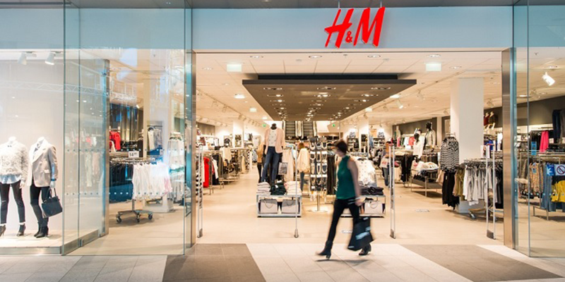

H&M Recommender system
NLP Classifier: Legal implications of chatbots My first Kaggle competition experience
Chen Tiancheng
Notes:
I will be presenting on my capstone project which is to build a recommender system for H&M and to share my first hand experience on an active Kaggle project.

Slide 2
Background
The dataset belongs to an active Kaggle competition which ran for 3 months from February 7, 2022 to May 9, 2022 (ended 4 days ago).
H&M Personalized Fashion Recommendations | Kaggle
Objective
Competition participants to develop product recommendations based on data from this previous transactions, customer and product meta data, and metric used to evaluate the submissions on Kaggle is Mean Average Precision @ 12 for purchase made in the next 7-day period. The higher the MAP@12, the better
Notes
I will be making purchase predictions for all customer_id values provided, regardless of whether these customers made purchases in the training data.
Customer that did not make any purchase during test period are excluded from the scoring.
There is never a penalty for using the full 12 predictions for a customer that ordered fewer than 12 items; thus, it's advantageous to make 12 predictions for each customer.
Notes:
The dataset belongs to a Kaggle competition that just ended 4 days ago
The objective is for competition participants to develop product recommendations predict the next 12 items that each customer will buy in the next 7-day period. This also explains what MAP@12 means.
As per the notes under the rules, I will not be penalized for making 12 full predictions per customer, so it is advantageous to do so

Slide 3
Why is a recommender system important for H&M?
In other words, why would H&M want to drop USD 50k on a Kaggle competition?
A good recommender can bring in sales, retain customer loyalty towards the brand
A good recommender can increase customer satisfaction to the purchased items, and thereby lowering returns through the H&M return policy
My motivation for doing this for capstone:
To get a first-hand experience on an active competition on Kaggle
Recommenders seem more front-end to me, a general direction I wish to pursue
Notes:
A good recommender can bring in sales, and lower returns as H&M has a return policy,
I chose this project also, to gain a first hand experience of an active Kaggle competition, and with the desire to do a more front end job which I can see my product in the future.

Slide 4
Exploratory data analysis
4 csv files, and 1 folder containing images. For the images, I did not have enough time to further incorporate it into my modelling.
Articles – all items sold in H&M
Transaction - Past 2 years from 2018 to 2020 September
Customer – 1.3m customer data
Sample - prediction template for submission on Kaggle
Note: I am just showcasing the key highlights for EDA later on, for further information on EDA that I have done, please refer to the Jupyter notebook.
Data relatively clean. General direction for dealing with null values just dropped as not really important data.
Notes:
For dataset, there are 4 CSV files, there is also a large zip folder containing images, but I did not have the luxury incorporate it in my model.
The 4 CSVs are
Articles – basically inventory sold at H&M
Transaction – 2 ful years worth
Customer data – 1.3m customer data
Sample –prediction template
Data is relatively clean, general direction I took was just to drop null values as not really important missing data was noted.

Slide 5
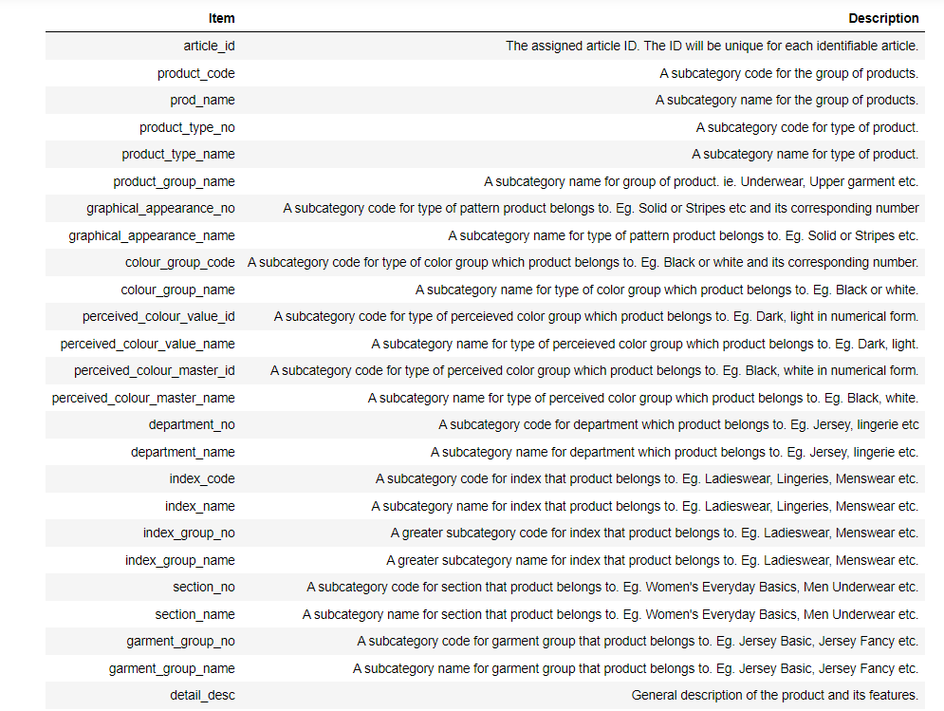
Articles EDA
Key highlights
1) 105,542 rows, which ties in with the 105,542 unique values of article_id.
2) Many features that can be used to distinguish between each product, numerical and textual
Will all 105,542 article_id be useful? Intuition that timing is important gave rise to base model
Notes:
Key highlights for articles dataset is that there are 100k unique rows of article_id
Also many features that can be distinguished.
So I asked myself the question of whether all 105k article id will be useful. I believe it is unlikely. Based on my understanding of Fast fashion and H&M, their items change based on their seasonal collection. As such we do not have clarity of which items are available for purchase in the period of prediction.

Slide 6
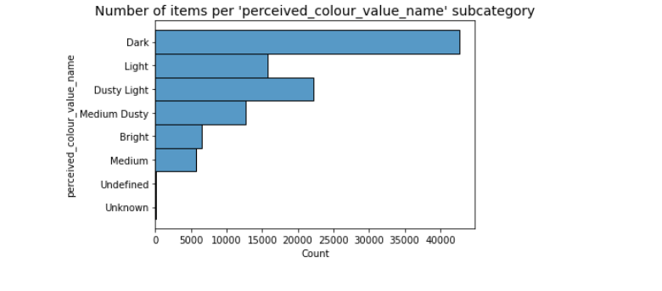
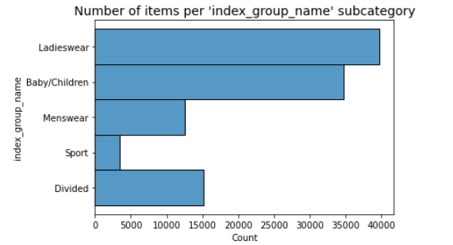
Articles EDA findings
Key highlights
Most items in H&M belong to the ‘Dark’ category.
Likely due to:
Customers demand – most customers buy dark colored clothes?
Or supply? – H&M optimizing based on dyes and material
There is also skewing of products towards Ladieswear and childrenswear.
Notes:
I found out that most items are Dark in color
This could be a function of demand or supply – where H&M optimizes based on dyes and material.
There is also skewing of products towards ladieswear and childrenswear.

Slide 7
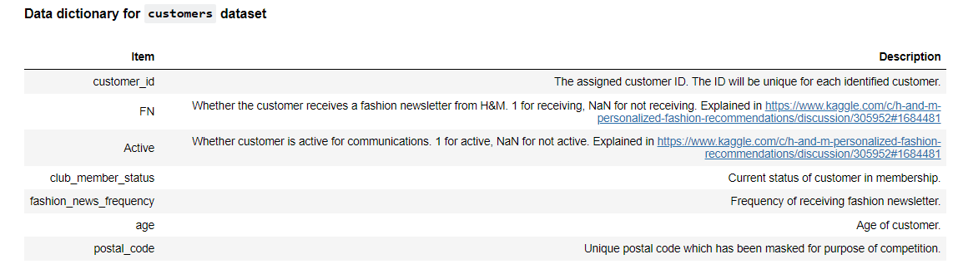
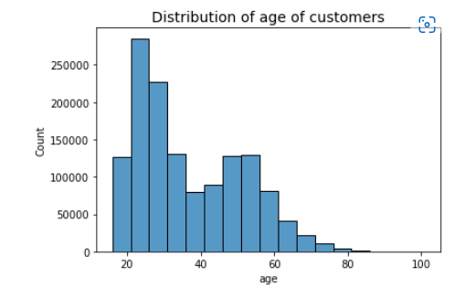
Customers EDA findings
Key highlights
Much less columns compared to articles dataset.
Most customers are in age group of 21-25.
After seeing the articles and customers dataset, I think I have enough data to create two model that profiles the customer by age, and similar customers, to predict their purchases. This will be talked about later.
Notes:
There is much less features here, as you can see from the data dictionary.
I found out that most customers are in age group of 21-25.
At this juncture after seeing the articles and customer dataset, 2 alternative models ie. Predicting by Age and grouping by clusters are areas that I would look at.

Slide 8
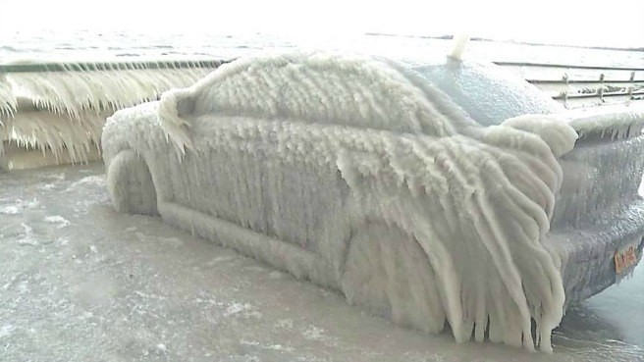
Transaction EDA findings
Cold start problem
0.7% of all customers may be new customers or customers who we do not have any past transaction data on.
55.43% of customers do not have more than 12 purchases made in the last 2 years.
Strategy: Similar to TikTok, need to use a general prediction in the form recommending best sellers
Notes:
From transaction data, there was a clear problem that I needed to deal with, which is the problem of cold start.

Slide 9
Base model
1) Very basic intuition: Customers who bought something most frequently and recently will buy that item again
Mechanics of model
2) Created a purchase dictionary – contains article_id and customer_id
3) Search purchase dictionary to determine if customer_id exists, recommend until 12
4) If don’t have 12, fill with best seller until 12
Best MAP@12 of 0.0208 using 5 weeks of transaction - Tried several permutation of weeks, but no improvement, explained this with tradeoff of historical data vs recency.
5 weeks is sweet spot, maybe because in September 2020 there was new season of clothing that got released.
H&M’s Fall Fashion 2020 collection showcases the beauty of recycled materials (hm.com)
At time of submission, I was around 1.4k position

Slide 10
Other strategies employed
Surfed Kaggle boards for higher scoring discussion, tested strategies that I learnt and understood.
Did not use collaborative filtering, as there were discussions that rule based seems to outperform those. (Prioritize on trying high scoring strategies)
Employed a total of 4 other Kaggle popular strategies
Light GBM (LGBM) Ranker
Learnt that other than classification and regression, there are ranker models
Weekly trending
Age
Kmeans - cluster of 12
Notes:
After getting the base model out, I tried to see what successful strategies people are employing.
I understood from their experience that when the dataset is so large, with so many product features and customers, it might not be that good in performance to do collaborative filtering.
Based on their experiences, they pointed out that rule based strategies performed better.
Also a mysterious LGBM Ranker model which I never heard of came to my attention, and not many people shared the code readily as it is supposed to be the winning formula.
So I tried 3 rule based models in addition, They are really nothing fancy, and similar to the base model, just different columns were manipulated into the dataframe.
I have also researched on how to do LGBM Ranker. Learning to Rank was a new type of modelling that was different from classifier and regression models that we were taught in GA.

Slide 11
Model evaluation
‘Age’ model did the best in MAP@12
LGBM Ranker did not improve with hyperparameter tuning
Try ensemble method before deciding what is final model
Around 1k position, improve by 400 positions
Notes:
I found that Age model did the best. Other rule based methods seems close.
My LGBM model did not do that well, even though it was supposed to be the winning formula. Unfortunately with hyperparams tuning I couldn’t get it to perform better.
So I chose to employ ensemble method next, as my rule based methods seems very biased. In reality, people’s preferences for purchase are likely to be diverse, and not just based on the
Their age, their profile, what is popular, and what is recent. However, it might be a mix, and other factors might be missed out. So that gives credit to try ensembling together.

Slide 12
Ensembling
“The theory of the “wisdom of crowds,” says that if you aggregate many different opinions from a diverse group of people, you are much more likely to arrive at the best opinion than if you just listen to one specialist.”
— Simon Kuper
With the ensemble of 5 models seen previously:
Final MAP@12 score: 0.0237 – further improvement of 4.4% from best ‘Age’ model
Around 600th position, improve by another 400 positions
Notes:
With ensembling, I managed to further improve

Slide 13
Ensembling
Some trials but no improvement (Ended up with no bronze medal on Kaggle ☹)
Tried ensembling less than 5 models. Tried using 6 and 7 models. Did not get better score.
Tried using LGBM using ½ year and 10 weeks in place of 5 weeks. Did not get better score.
Tried different weights. No better score.
Observation and learning point
Ensembling seems to work better with more diverse models being put together.
Scores between 200th to 600th position were very tight, around 0.0241 gives 200+ position at time of competition.

Slide 14
Learning points
Google Colab GPU and High RAM can be requested. This can help to run high requirement notebooks.
Parquet, and memory saving techniques can be helpful to reduce size of data by up to 8 or 16 times.
Some tricks learnt – strings use 64 bytes, if converted to int64, it is only 8 bytes. Just need to add back the leading 0 afterwards before submission.
Others: conversion to int8 and float32.
RAPIDS cuDF can speed up running of notebook from 2hours to few minutes. Supported on Google Colab but need to run the code each time to install each time I restart.
I finished top 25-30% of all teams

Slide 15
Learning points (Kaggle)
After 50 Kaggle submissions:
Kaggle discussion boards are a good place to learn first hand.
Testing out their strategies quickly with a team will allow improvement of scores.
Don’t go solo, group up and test strategies.
If possible team up with more experienced people to learn more.

Slide 16
Areas of future work
Comparing against top models on Kaggle competition – ended 4 days ago, so winning strategies are popping up.
Can visit and understand state of the art recommender systems (Really wins a lot more than the masses on Kaggle, close to double in MAP@12)
LGBM Ranker model coding and syntax is quite sparse online.
Hoping that top codes can disclose how it was done.
First cut main difference in their models versus mine is:
They employ up to 21 candidate selection methods.
After the candidate selection method, then they pass it through LGBM Ranker.
Some top models use multiple LGBM models with different weeks transaction ensembled together.

Slide 17
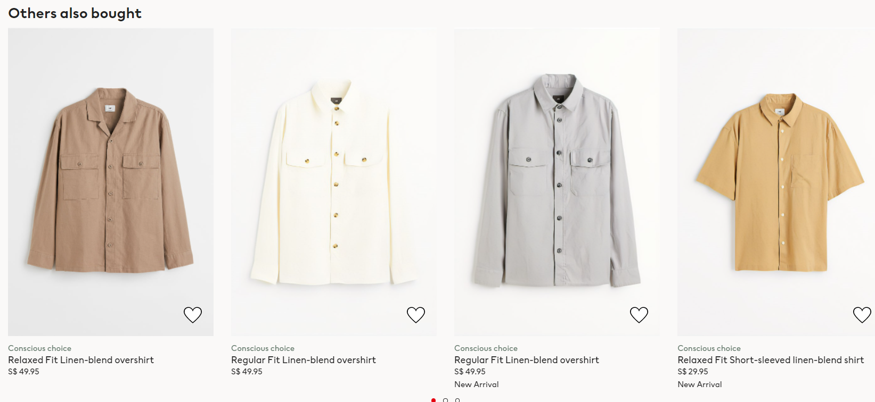
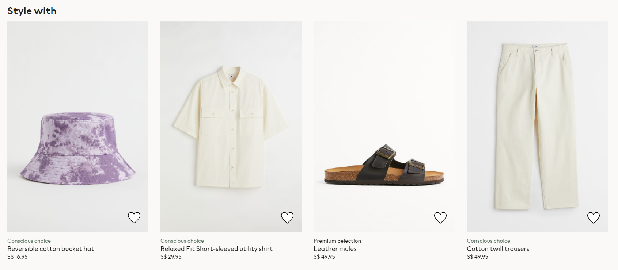
So what now?
Lowest MAP@12 model may not be used for production as seen from Netflix prize. Winning solutions are very computationally heavy, and requires lots of data and storage.
I recommend H&M to consider using 5 weeks for their model. This is my main finding, that it is roughly the sweet spot for highest MAP@12.
Recommend usage of several simpler models. Gold standard reference being Netflix.

Slide 18
AI Video
Synthesia STUDIO: Your AI video

